Slide 1


Slide 2


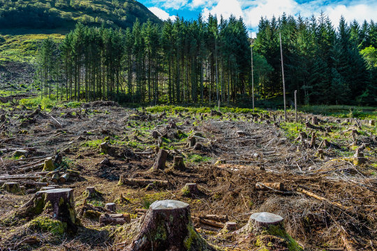
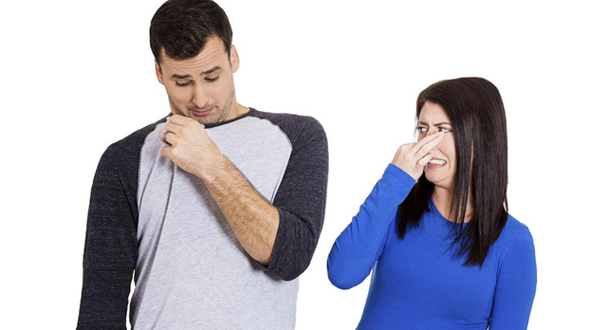


PROBLEMS / PAIN POINTS
SWEAT
DEFORESTATION
FOUL ODOUR
SOLUTION

Slide 3
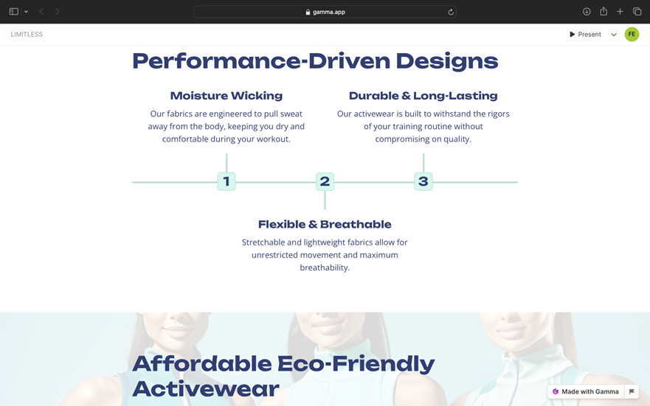

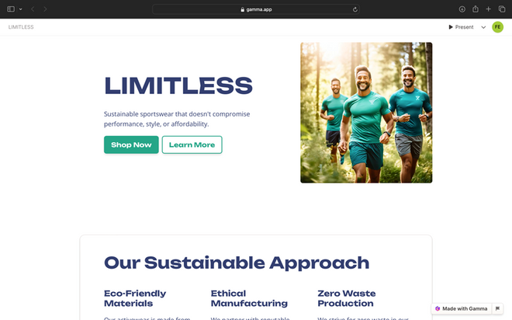
WHY US?
VISIT US

Slide 4
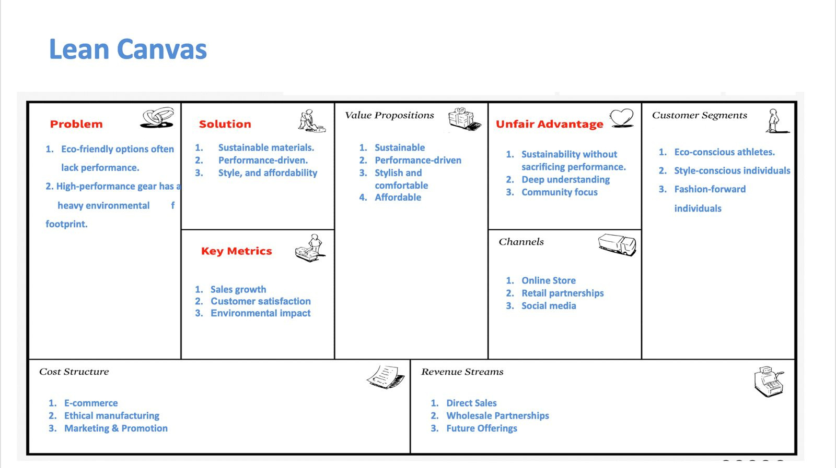
LEAN CANVAS MODEL

Slide 5
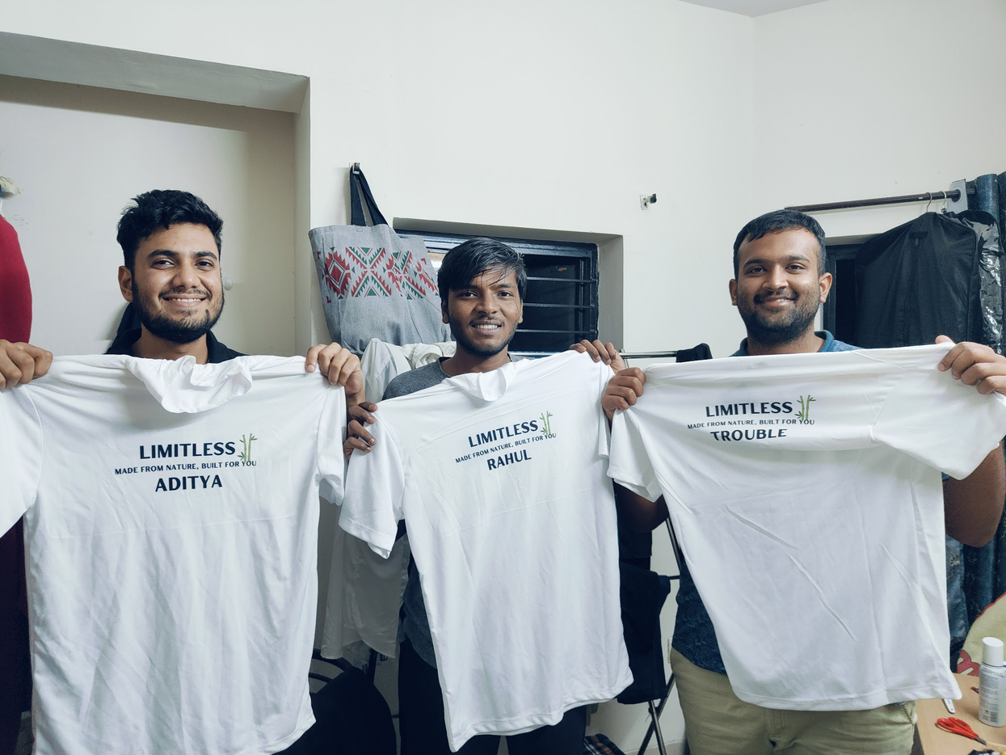
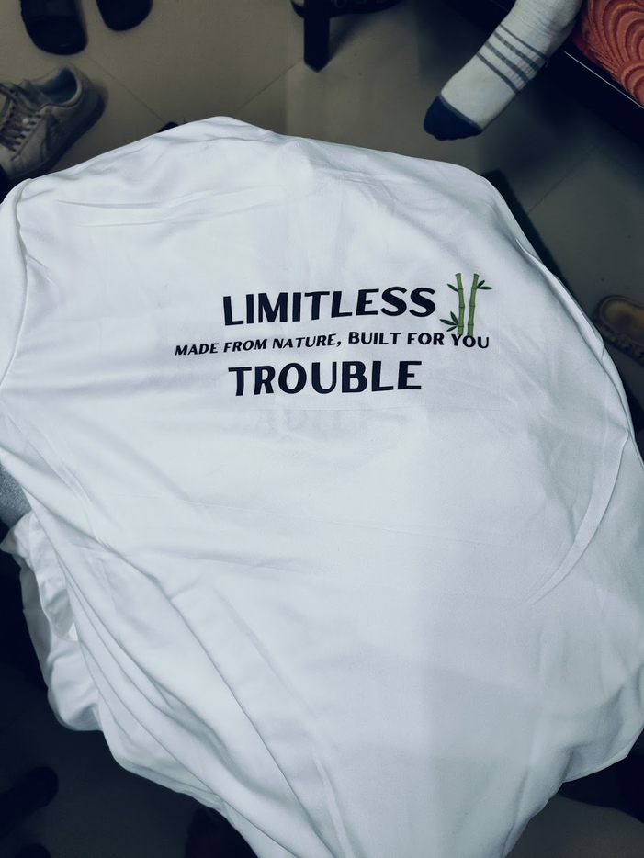
PROTOTYPES AND THEIR PICTURES

Slide 6
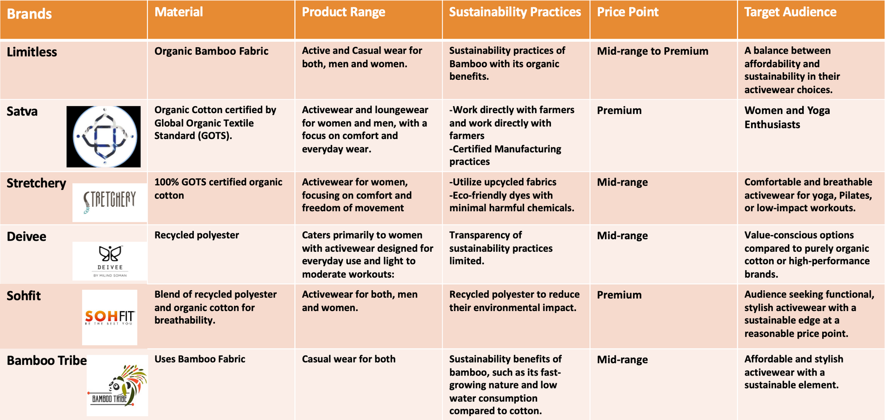
COMPETITOR ANALYSIS

Slide 7
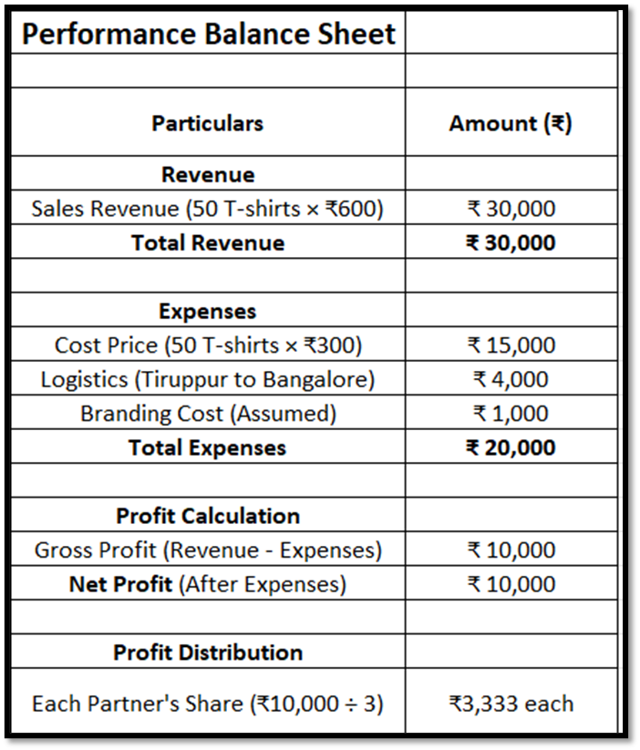
INITIAL RESULTS

Slide 8
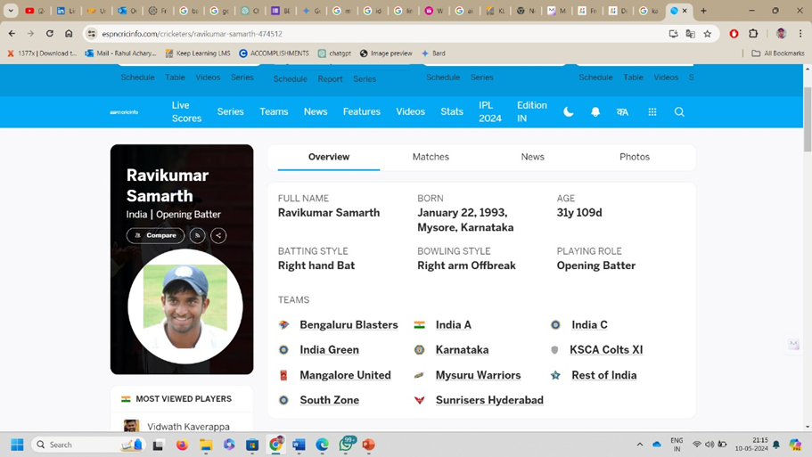
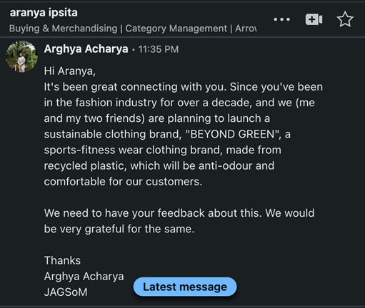
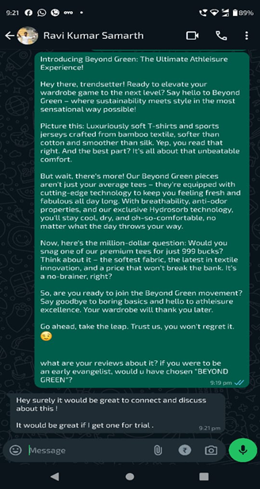
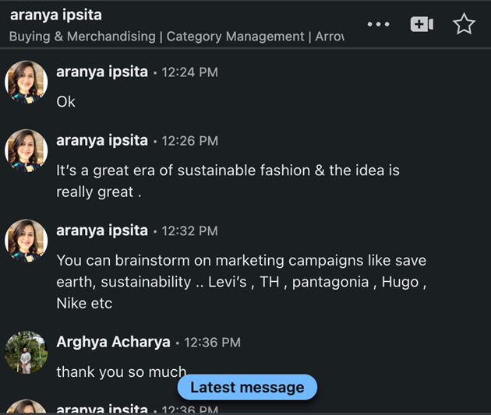
INITIAL RESULTS

Slide 9
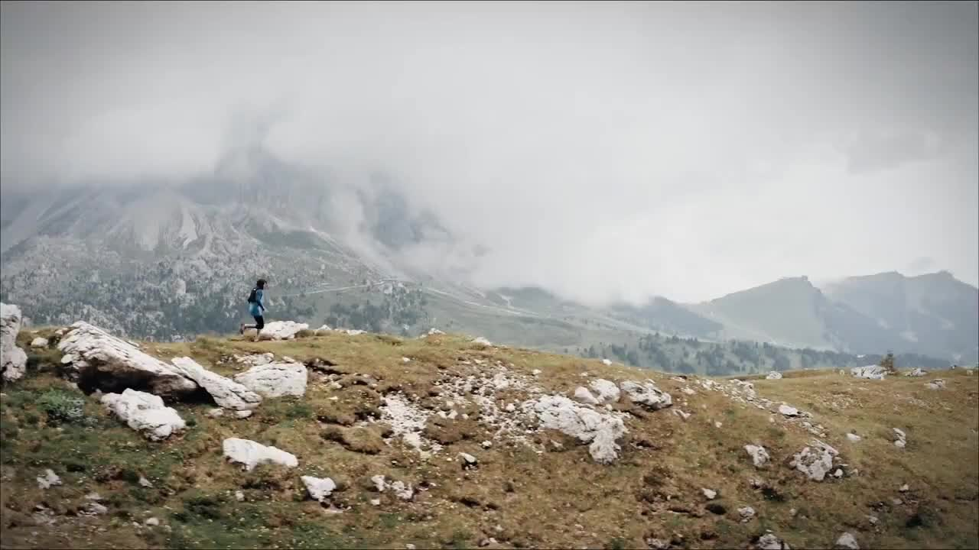
TEASER LAUNCH VIDEO

Slide 10
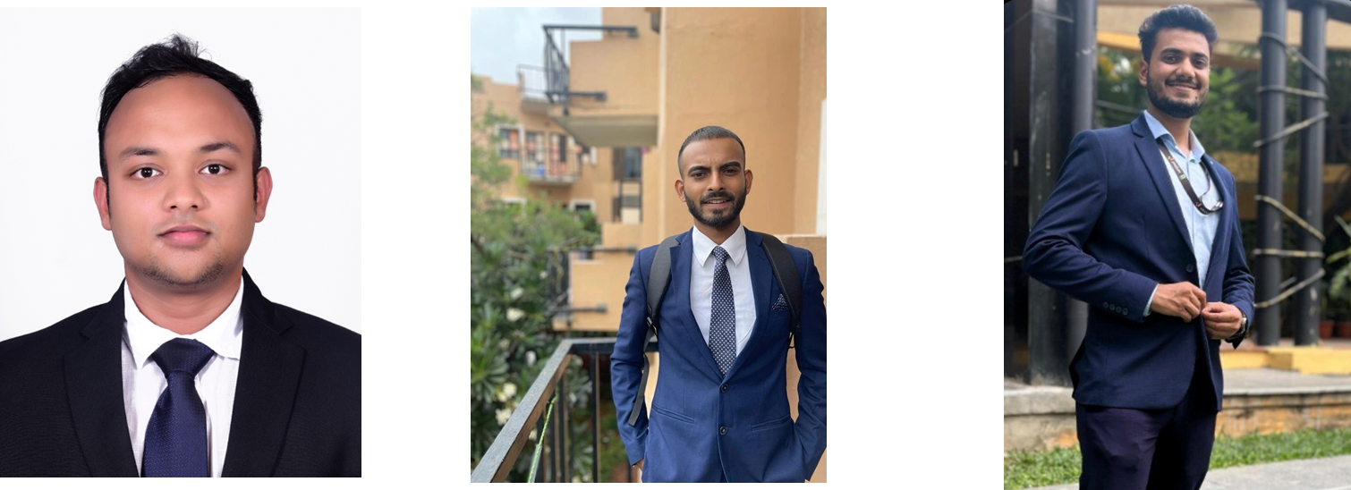

FOUNDING TEAM
Arghya Acharya
Rahul Acharya
Aditya Tiwari

